Slide 1
Reaching the Magical Plateau
Alejandro Torres
Notes:
Today I want to discuss how if we can optimize our with Major League Baseball team with the right players, our odds are dramatically increased in hitting the magical plateau of 95+ wins to head into the world series

Slide 2
Table of Contents
01
Background
Bringing context to our discussion
02
Why is this important
Hypothesis and measurements for our goal
03
Understanding the data
Data set breakdown and methodology
04
Analysis
Reviewing correlation and mean
05
Testing
T-Tests for ERA and OBP
06
Putting it all together
Target goals and confidence
07
Conclusion
Target goals and confidence
Notes:
What
Major League Baseball franchises are looking for whatever advantage possible to get to the world series and the magical plateau
Why
Discuss what type of players we need in order to get that edge in order to have a winning season and get our team into the World Series
How
Today we will discuss how we can improve our chances of winning by analyzing 2 particular stats, Earned Run Averages and On-Base Percentages

Slide 3
Background
01
Bringing context to our discussion
Moneyball
Significance
Sabermetrics
The power of data
Impact on baseball
Notes:
Major League Baseball franchises are looking for whatever advantage possible to get to the world series.
"Moneyball", has helped conceptualized the importance of gathering and analyzing data for the MLB.
What does this mean?
For the uninitiated, "Moneyball" popularized Sabermetric principles, essentially utilizing a quantitative approach to baseball applying mathematical and statistical analysis of baseball records to evaluate players past performance and predict future performance.
Moneyballs changed the game in countless ways, from the scouting department to the actual on-field play.

Slide 4
Why is this important?
02
Hypothesis and measurements for our goal
There is no significant difference in wins based on ERA (earned run avg.)
Ho: μ1-μ2=0
Ha: μ1-μ2≠0
Earned Run Average (ERA):
Represents a players number of earned runs a pitcher allowed per nine innings without the aid of an error or passed ball.
On-Base
Hypothesis
2. There is no significant difference in based on On-Base Percentage (OBP)
Ho: μ1-μ2=0
Ha: μ1-μ2≠0
On-Base Percentage (OBP):
Refers to a baseball players frequency of reaching a base.
Objective? Win games and play in the World Series!
Notes:
A commonly understood part of baseball is to have a chance of heading to the World Series is having 95 wins in the regular baseball season
with that in mind let
Our Hypothesis has to do with ERA and OBP player stats
Looking at ERA
What does this mean? The ERA tells us how well a pitcher prevented runs from scoring.
What is OBP
Well, A hitter wants to hit the pitch and score. OBP provides insight on which hitters are more successful with this goal
Our ultimate goal is to look at these stats in relation to players and understand the statistical significance between ERA/OBP and wins
Error is a judgement of official advising of a misplay that allows the player to advance to a base - for example if an outfielder drops the ball during a catch. Batter still gets credit
Passed ball - if a catcher fails to hold or control a legally pitched ball that should have been caught (stolen base)

Slide 5
Understanding the Data
Data set:
All Major League Teams (MLB) from 1976 through 2019
8 numerical variables within data set
Wins, Hits, Walks to base, At bat, Flies, Hit by pitch, ERA, OBP*
Data originated from Sean Lahman
Teams.csv
Methodology:
Reviewed correlations between ERA’s/OBP’s and wins
Pearson test: p-values were <.05
T-test ran on resulting variables to verify data
Utilized Pandas, Scipy, Seaborn, and Matplotlib within Google Colaboratory
Notes:
Data set:
All Major League Teams from 1976 through 2019
All baseball teams within a 43 year period through 2019
Please note - Omitted 2020 as it was impacted by Covid and only lasted 60 games
8 numerical variables within data set
Why did we need to expand the scope of variables? Well
OBP is not within the dataset so within our Python script we used the following calculation of
of Hits + Walks + Hit by Pitch / At bats + Walks + Hit by Pitch + Sacrifice Flies
to obtain the On-Base Percentage, verifying accuracy.
Hits - hen the batter safely reaches or passes first base after hitting the ball into fair territory
Walks - A walk (or base on balls) occurs when a pitcher throws four pitches out of the strike zone
Hit by Pitch - hit-by-pitch occurs when a batter is struck by a pitched ball without swinging at it.
At bats - An official at-bat comes when a batter reaches base via a fielder's choice, hit or an error (not including catcher's interference) or when a batter is put out on a non-sacrifice.
Sacrifice flies - when a batter hits a fly-ball out to the outfield or foul territory that allows a runner to score
Data originated from Sean Lahman (LAYman)
Teams.csv
Created by Sean Lahman, this Data base contains pitching, hitting and fieldings statistics for Major League Baseball.
Why are his stats relevant?
Well he pioneered the effort to make baseball statistics freely available to the general public. What started as a one man effort in 1994 has grown tremendously, and now a team of researchers have collected their efforts to make this the largest and most accurate source for baseball statistics available anywhere.
Methodology:
Testing to determine if sample was biased
Completed testing to verify that this data is represented accurately
Reviewed correlations between ERA’s/OBP’s and wins
Understand the correlation with the data
Pearson test - p-values were <.05
Ran Pearson Test (measures a linear dependence between two variables) to verify a significant relationship
T-test ran on resulting variables to verify data
Tested relationships for teams with greater than 81 wins and less than 81 wins (81 games being ½ a baseball season)
Utilized Pandas, Scipy, Seaborn, and Matplotlib within Google Colaboratory
Imported several tools with Python script to assist with testing and visualizations
Pandas - Python library for data analysis
Scipy - SciPy is a collection of mathematical algorithms and convenience functions for python
Seaborn - Seaborn is a data visualization library
Matplotlib - Matplotlib is a comprehensive library for creating static, animated, and interactive visualizations in Python
Google Colab - Colab allows anybody to write and execute arbitrary python code through the browser
Python - High level programming language
I know that was a lot of information but I promise this will be helpful as we move forward

Slide 6
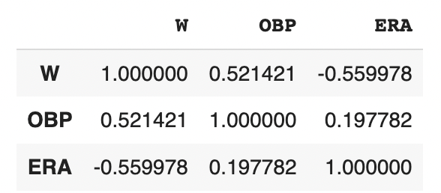
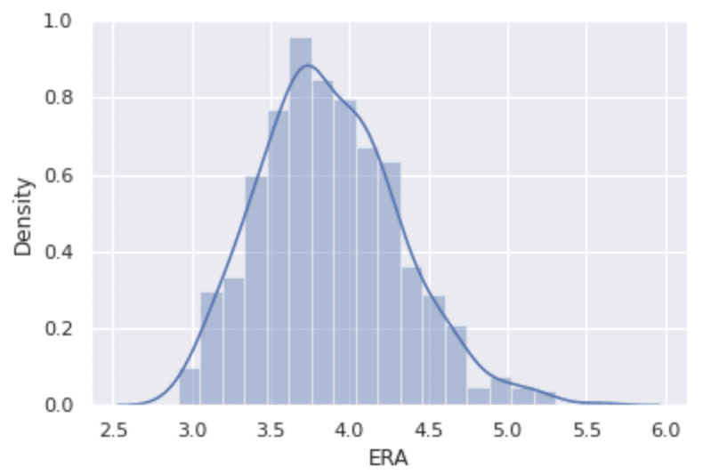
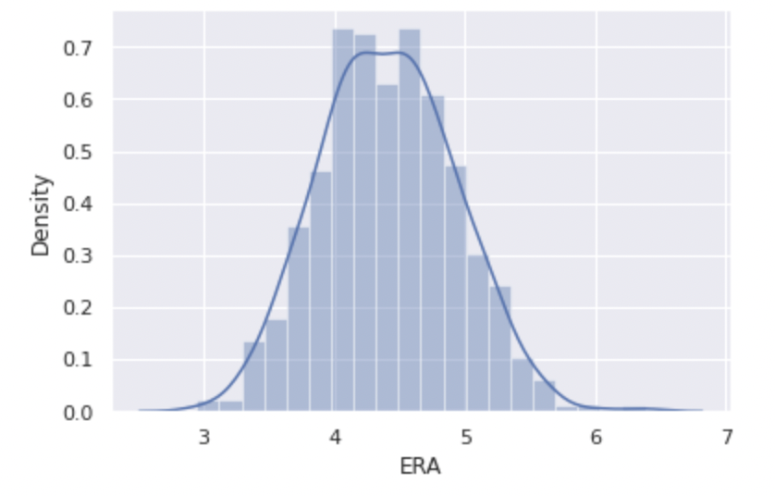
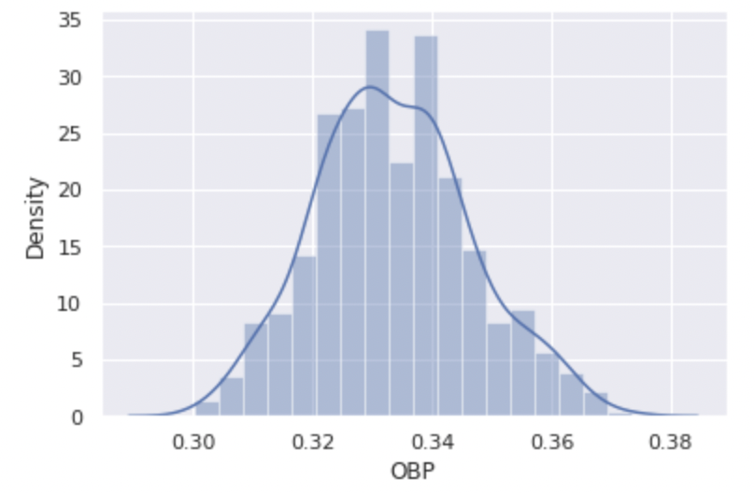
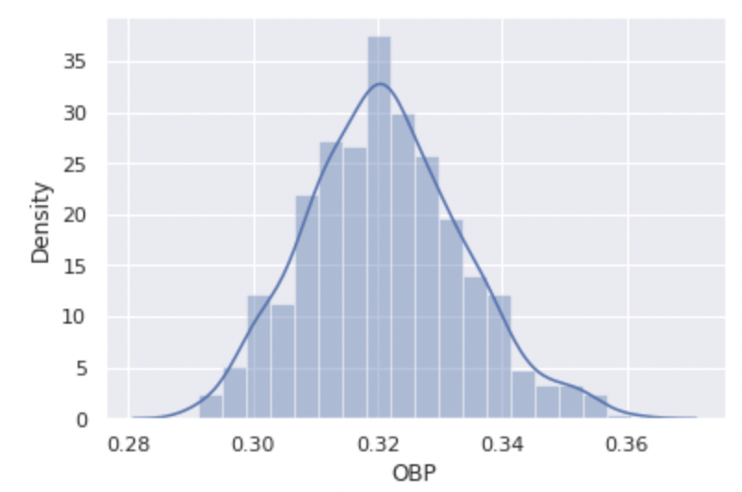
Analytics
Correlation:
Mean - High Winning Teams:
Mean - Low Winning Teams:
Notes:
Looking at the data analytics, first we have
Correlations:
Positive correlation between Wins and OBP
Negative correlation between Wins and ERA’s
So with a P value greater than <.001 (p-value being the level of marginal significance within a statistical hypothesis test) we have determined that there is a strong linear relationship between the two datasets
We can now reject our previously stated null hypothesis
Establishing that to increase win rate we want players with higher OBP and Lower ERA
Test OBP and ERA of teams within more and less than median of 81 wins (162 games in a typical baseball season)
Created a DataFrame with teams that won more than 81 games within a season while also creating a Dataframe with teams that won less than 81 games within a season
High Winning Teams Mean of Data range?
ERA = 3.87 OBP = .333
Low Winning Teams Mean of Data range?
ERA = 4.41 OBP = .321
So we found the median of ERA’s and OBP’s for high and low winning teams, what are we doing this?

Slide 7
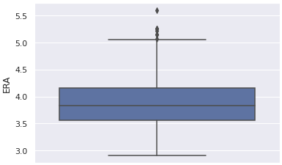
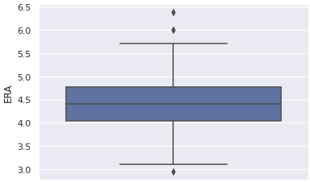
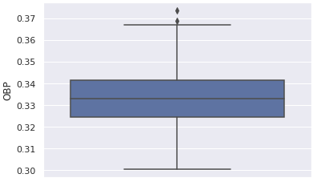
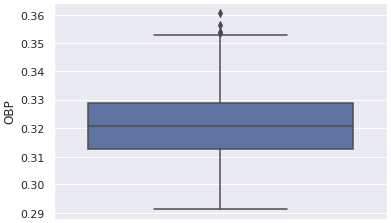
Testing
T-Test - ERA
Over 81 Wins:
Under 81 Wins:
T-Test - OBP
Over 81 Wins:
Under 81 Wins:
Notes:
Here we are Looking at T-Test results - We have just established a relationship between ERA & Wins and OBP & Wins.
Here we test the relationships between those teams with greater than < 81 wins and those with less than 81 wins.
Starting off with ERA
ERA:
With a p-value of greater than < .001, we can reject the null hypothesis. There is a significant difference in ERA when comparing teams with more and less wins
You can see the difference with teams with more than 81 wins have an Inter Qualrtile (INTERCORE-TILE) Range mostly below 4 and teams that have less than 81 wins have an Inter Quartile Range above 4.
OBP:
With a p-value of greater than < .001, we can reject the null hypothesis. There is a significant difference in OBP when comparing teams with more and less wins.
You can see the difference with teams with more than 81 wins have an Inter Qualrtile Range form .325 to .34 and teams that have less than 81 wins have an Inter Quartile Range from .315 to .33.
Interquartile Range - Spread of the middle ½ of the distribution

Slide 8
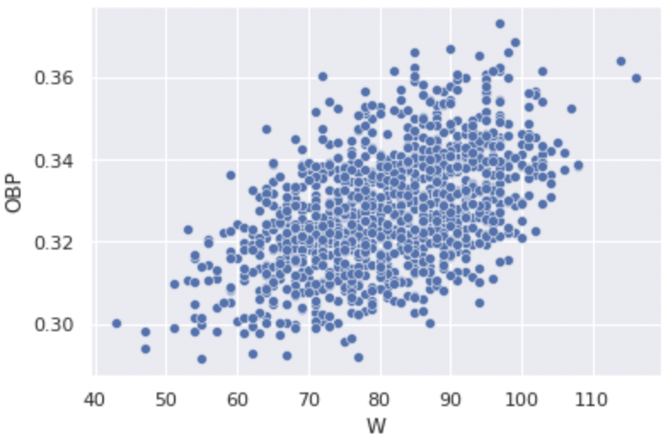
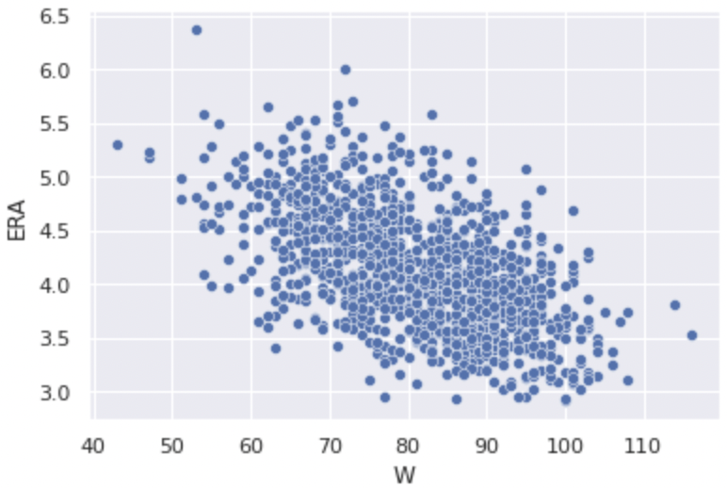
Putting it all together
Targets:
OBP = .337
ERA = 3.74
Notes:
And with a Difference in means at a 95% confidence interval is between 0.482 and 0.595.
the results show that as OBP rises, Wins increase
And the opposite is true for ERA. As it lowers, Wins increase.
When reevaluating and adjusting your roster throughout the year, aim to add and remove players inorder to hit the target OBP and ERA. This will ensure you have the best chance to reach the 95 win target, increasing your chances of heading to the world series

Slide 9
THANK YOU
Questions?
Notes:
What
Why
How

